Slide 1
Lecture # 3 (Final) Processor Logic Design

Slide 2
Introduction
A processor unit is that part of a digital system that implements the operations in the system.
It comprises a number of registers and the digital functions that implement arithmetic, logic, shift, and transfer micro-operations.
The processor unit, when combined with a control unit that supervises the sequence of micro-operations, is called a central processing unit (CPU).
Central Processing Unit (CPU) consists of Memory (Register Banks), Arithmetic Logic Unit (ALU) and Control Unit (CU).
There are three organizations for organizing a general-purpose processor unit:
Bus organization
Scratchpad memory
Two-port memory

Slide 3
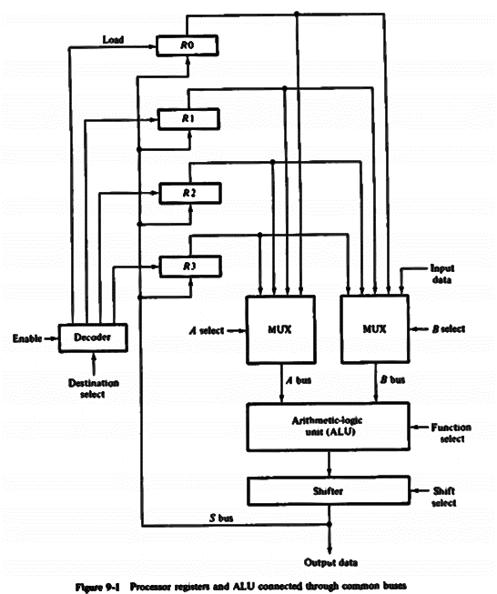
Bus Organization
A bus organization has 4 registers, each register is connected to 2 multiplexers to form 2 buses A and B.
To perform the micro-operation:
R1 = R2 + R3
The control unit must provide binary selection variables to the following selector inputs –
MUX A Selector: to place contents of R2 onto bus A
MUX B Selector: to place contents of R3 onto bus B
ALU Function Selector: to provide the arithmetic operation A + B
Shift Selector: for direct transfer from the output of the ALU onto output bus S (no shift)
Decoder Destination Selector: to transfer the contents of bus S into R1
Fig. 9.1 Processor registers and ALU connected through Common Buses

Slide 4
Bus Organization
The five control selection variables must be generated simultaneously and must be available during one common clock pulse interval.
The binary information from two source registers propagates through the combinational gates in the multiplexers, the ALU, and the shifter, to the output bus and into the inputs of the destination register all during one clock pulse interval.
Then, when the next clock pulse arrives, the binary information on the output bus is transferred to R1.

Slide 5
Scratchpad Memory
The registers in a processor unit can be enclosed within a small memory unit. When included in a processor unit, a small memory is sometimes called a scratchpad memory.
The use of a small memory is a cheaper alternative to connecting processor registers through a bus system. The difference between the two systems is the manner in which information is selected for transfer into the ALU.
In the bus system, the information transfer is selected by the multiplexers that form the buses.
On the other hand, a single register in a group of registers organized as a small memory must be selected by means of an address to the memory unit.

Slide 6
Scratchpad Memory
To perform the operation R1 = R2 + R3, the control must provide binary selection variables to perform the following sequence of three microoperations:
T1: A ← M[010] Read R2 into register A
T2: B ← M[011] Read R3 into register B
T3: M [001] ← A+B Perform the operation in ALU and transfer the result to R1
The reason for a sequence of 3 microoperations, instead of just 1 as in a bus-organized processor, is due to the limitation of the memory unit having only one set of address terminals but two source registers are to be accessed. So, multiple memory addresses can’t be accessed simultaneously.
Fig. 9.2 Processor unit employing a scratchpad memory

Slide 7
Processor Unit with 2-Port Memory
Some processors employ a 2-port memory to overcome the delay caused when reading two source registers.
If the destination register is the same as one of the source registers, then the entire micro-operations can be done within one clock pulse period.
Fig. 9.3 Processor unit with a 2-port memory

Slide 8
Processor Unit with 2-Port Memory
When CP = 1, A and B latches are open and accept information coming from memory. The WE is also in a HIGH state and disables write operation and enables read operation. Thus, when CP = 1, words selected by A and B addresses are read from memory and placed in A and B registers.
When CP = 0, the latches are closed and retain the last data entered. ALU operation is performed and if a write is enabled since CP = 0, and also ME input is enabled, the result of the micro-operation is written into memory word defined by B address.
1
=1
Fig. 9.3 Processor unit with a 2-port memory

Slide 9
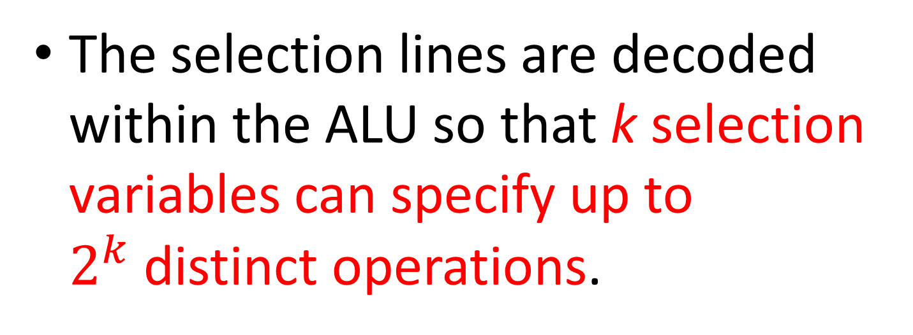
Arithmetic Logic Unit (ALU)
An Arithmetic Logic Unit (ALU) is a multi-operation, combinational logic digital functional circuit.
The ALU can perform a set of basic arithmetic and logic operations.
The ALU has several selection lines to select a particular operation in the unit.
The selection lines are decoded within the ALU so that k selection variables can specify up to $2^{k}$distinct operations.

Slide 10
Arithmetic Logic Unit (ALU)
The mode select s2 distinguishes between arithmetic and logic operations.
The two function-select inputs s1 and s0 specify the arithmetic and logic operation to be generated.
The input and output carry (C_{in} and C_{out}) have meanings only during arithmetic operations.
The input carry C_{in} in the least significant position of an ALU is quite often used as the fourth selection variable that can double the number of arithmetic operations. Thus, a total of 8 arithmetic operations and 4 logical operations can be performed.

Slide 11
Design of Arithmetic Circuit
The basic component of the arithmetic section of an ALU is the parallel adder.
A parallel adder is constructed with a number of full adder circuits cascaded.
By controlling the data inputs to the parallel adder, it is possible to obtain different types of arithmetic operations.

Slide 12
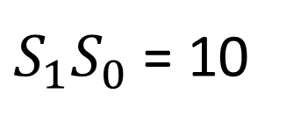
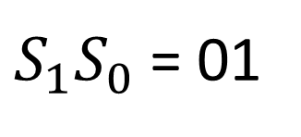
Operations obtained by controlling one set of inputs to a parallel adder
$S_{1}S_{0}$ = 01
(a) Addition without input carry
(b) Addition with input carry
$S_{1}S_{0}$ = 10
(c) Addition with 1’s complement of B
(d) Subtraction
Fig. 9.6

Slide 13
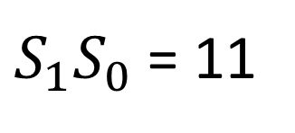
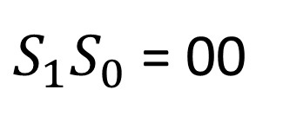
Operations obtained by controlling one set of inputs to a parallel adder
$S_{1}S_{0}$ = 00
(e) Transfer of A
(f) Increment of A
$S_{1}S_{0}$ = 11
(g) Decrement of A
(h) Transfer of A
Fig. 9.6

Slide 14
The condition illustrated in Fig. 9.6 (g) inserts all 1s into the B terminals. This produces the decrement operation, F = A – 1. To show that this condition is indeed a decrement operation, consider a parallel adder with n full-adder circuits. When the output carry is 1, it represents the number 2^{n} because 2^{n} in binary consists of a 1 followed by n 0s. Subtracting 1 from 2^{n}, we obtain 2^{n} – 1, which in binary is a number of n 1s. Adding 2^{n} – 1 to A, we obtain F = A + 2^{n} – 1 = 2^{n} + A – 1. If the output carry 2^{n} is removed then we obtain the decrement operation, F = A – 1.
To demonstrate with a numerical example, let us consider, n = 8 and A = 9. Then
A = 0000 1001 = 9
2⁸ = 1 0000 0000 = 256
2⁸ – 1 = 1111 1111 = 255
A + 2⁸ – 1 = 1 0000 1000 = 256 + 8
Removing the output carry 2^{n} = 256, we obtain 8 (i.e., 9 – 1). Thus, we have decremented A by 1 (from 9 to 8) by adding to it a binary number with all 1s.

Slide 15
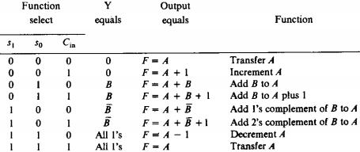
Function Table for Arithmetic Circuit
Table 9.1 Function Table for the arithmetic circuit of Fig. 9.8

Slide 16
Functions of Arithmetic Circuit
The circuit that controls input B to provide the functions illustrated in Fig. 9.6 is called a true/complement, one/zero element. The circuit is illustrated in Fig. 9.7.
Two selection lines s₁ and s₀ control the input of each B terminal. The diagram shows one typical input designated by Bi and an output designated by Y_{i}.
In a typical application, there are n such circuits for i = 1, 2, 3, ……, n.
As shown in the Table of Fig. 9.7, when both s₁ and s₀ are equal to zero, the output Y_{i} is equal to 0 regardless of the value of B_{i}.
When s₁ = 0 and s₀ = 1, the top AND gate generates the value of B_{i} while the bottom AND gate output is 0; thus the output Y_{i} is equal to B_{i}.
With s₁ = 1 and s₀ = 0, the bottom AND gate generates the complemented value of B_{i} while the top AND gate output is 0; thus the output Y_{i} is equal to B’_{i}.
Finally, when both s₁ = 1 and s₀ = 1, both the top and bottom AND gates generate the normal and complemented value of B_{i} respectively; thus the output Y_{i} is equal to B_{i} + B_{i}’, which is equal to 1.
These are illustrated in the Table of Fig. 9.7

Slide 17
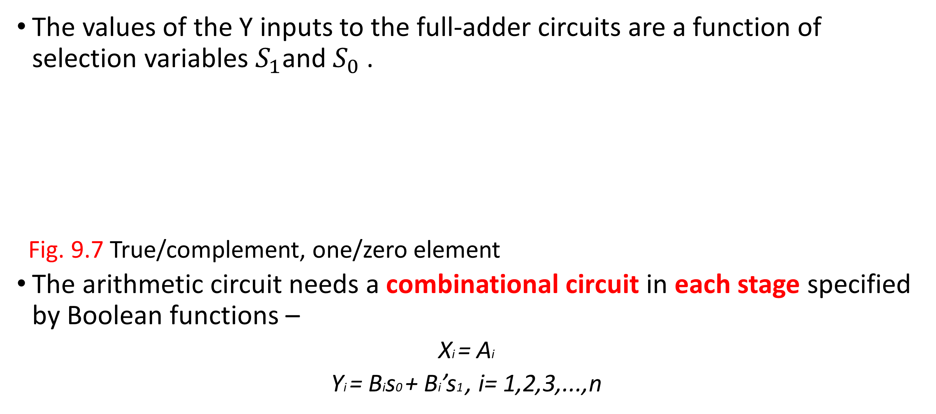
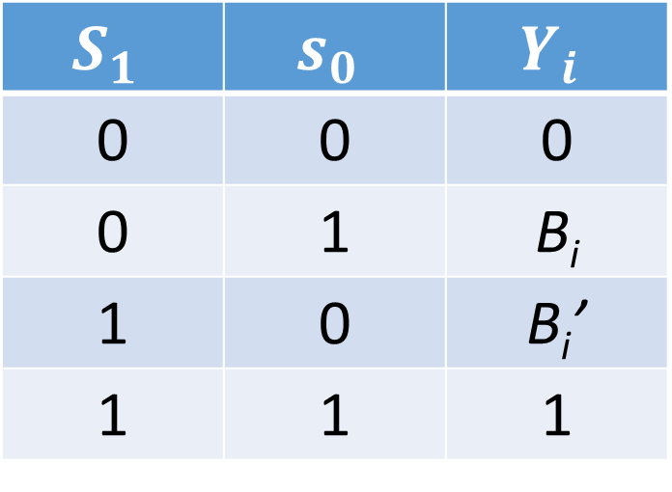
True/Complement, One/Zero Circuit
The values of the Y inputs to the full-adder circuits are a function of selection variables $S_{1}$and $S_{0}$.
Fig. 9.7 True/complement, one/zero element
The arithmetic circuit needs a combinational circuit in each stage specified by Boolean functions –
Xi = Ai
Yi = Bis0 + Bi’s1 , i= 1,2,3,...,n
$$S_{1}$$ | $$s_{0}$$ | $$Y_{i}$$
0 | 0 | 0
0 | 1 | B_{i}
1 | 0 | B_{i}’
1 | 1 | 1

Slide 18
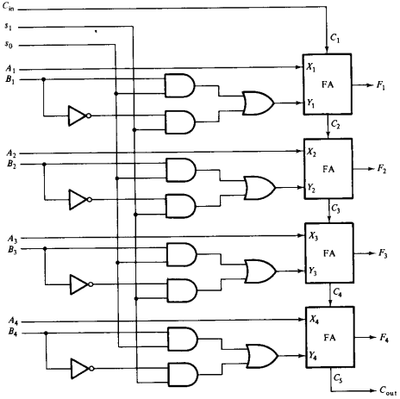
Logic Diagram of an Arithmetic Circuit
Figure 9-8 Logic Diagram of a 4-bit Arithmetic Circuit

Slide 19
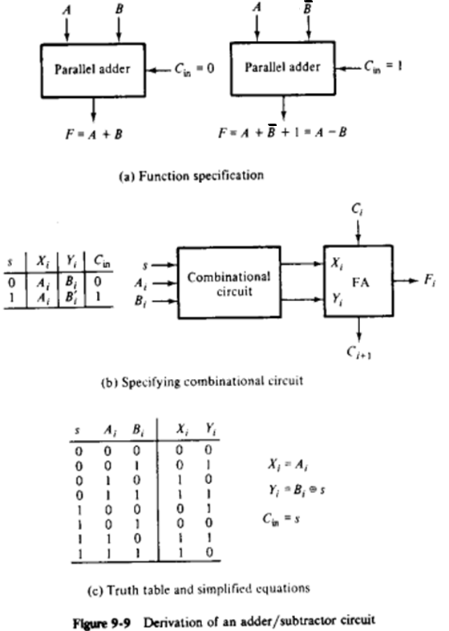
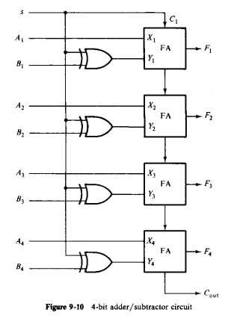
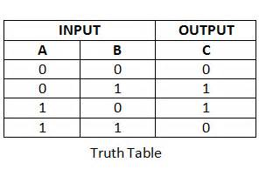
Exercise (Home Work)
Design an adder/subtractor circuit with one selection variable s and two inputs A and B: when s = 0 the circuit performs A+B. When s = 1 the circuit performs A-B by taking the 2’s complement of B.
X_{i} = A_{i}
Y_{i} = B_{i} XOR s
C_{in} = s
Truth Table of XOR gate
s | F | X | Y | C_{in}
0 | A+B | A | B | 0
1 | A-B | A | B’ | 1

Slide 20
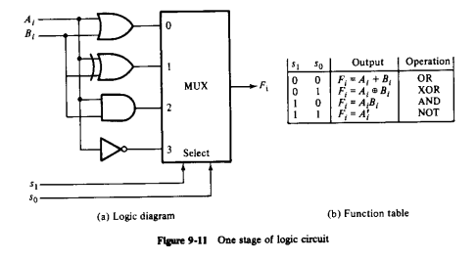
Design of a Logic Circuit
The logic microoperations manipulate the bits of the operands separately and treat each bit as a binary variable.
All logic operations can be obtained by means of AND, OR and NOT operations.
For 3 operations, we need 2 selection variables but 2 selection lines can choose between 4 logic operations and hence XOR operation was also incorporated in the logical circuit.

Slide 21
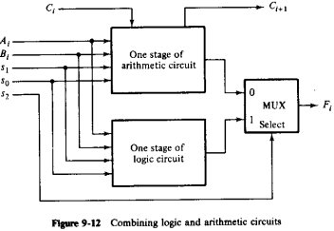
Combining Logic and Arithmetic Circuits
The logic circuit can be combined with the arithmetic circuit to produce one arithmetic logic unit.
Selection variables s1 and s0 can be made common to both sections provided we use a third variable s2 to differentiate between the two.
This third variable is the select input to a 2:1 multiplexer.

Slide 22
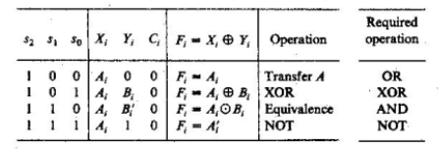
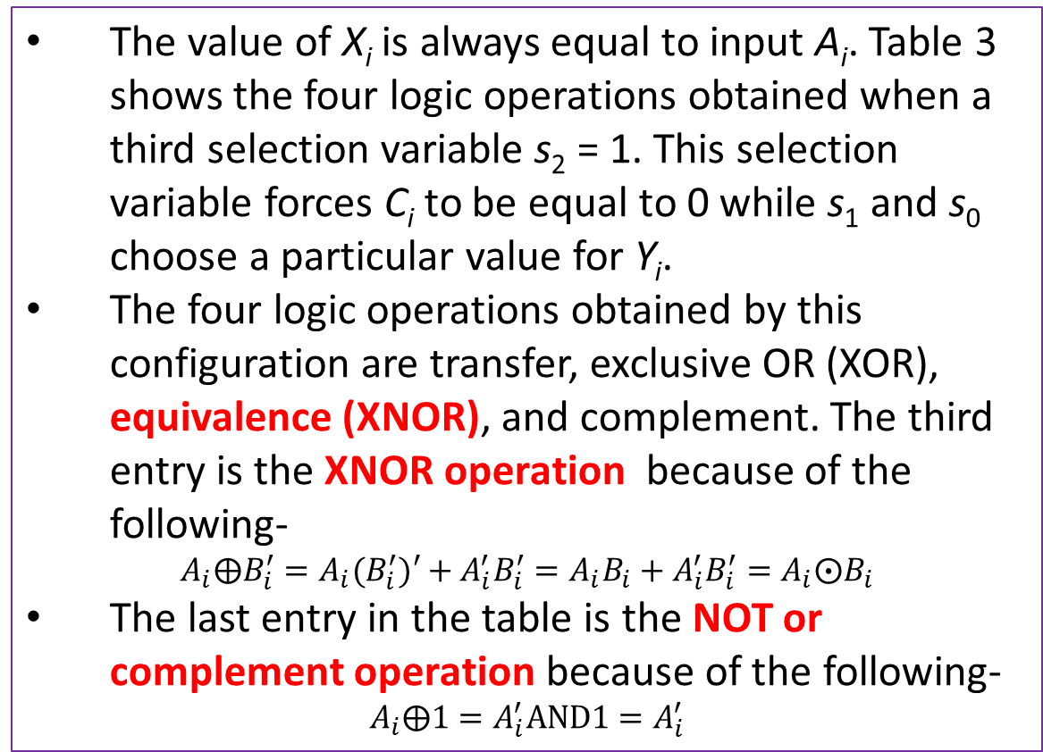
Problems of combining the Arithmetic and Logic Circuits in one stage
Table 3. Logic operations of the combined arithmetic and logic circuits
Arithmetic
Logic
The value of X_{i} is always equal to input A_{i}. Table 3 shows the four logic operations obtained when a third selection variable s₂ = 1. This selection variable forces C_{i} to be equal to 0 while s₁ and s₀ choose a particular value for Y_{i}.
The four logic operations obtained by this configuration are transfer, exclusive OR (XOR), equivalence (XNOR), and complement. The third entry is the XNOR operation because of the following-
$$A_{i}⨁B_{i}^{′}=A_{i}{(B}_{i}^{′})′+A_{i}^{′}B_{i}^{′}=A_{i}B_{i}+A_{i}^{′}B_{i}^{′}=A_{i}{⨀B}_{i}$$
The last entry in the table is the NOT or complement operation because of the following-
$$A_{i}⨁1=A_{i}^{′}AND1=A_{i}^{′}$$
How to
map
How to
map
XNOR gate gives an output “1” when its inputs are “logically equal” or “equivalent” to each other, which is why an Exclusive-NOR gate is sometimes called an Equivalence Gate.
Input |  | Output
A | B | A XNOR B
1 | 0 | 0
1 | 1 | 1

Slide 23
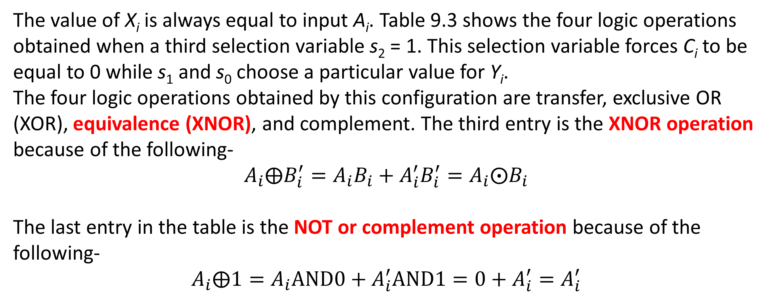
Problems of combining the Arithmetic and Logic Circuits in one stage
The value of X_{i} is always equal to input A_{i}. Table 9.3 shows the four logic operations obtained when a third selection variable s₂ = 1. This selection variable forces C_{i} to be equal to 0 while s₁ and s₀ choose a particular value for Y_{i}.
The four logic operations obtained by this configuration are transfer, exclusive OR (XOR), equivalence (XNOR), and complement. The third entry is the XNOR operation because of the following-
$$A_{i}⨁B_{i}^{′}=A_{i}B_{i}+A_{i}^{′}B_{i}^{′}=A_{i}{⨀B}_{i}$$
The last entry in the table is the NOT or complement operation because of the following-
$$A_{i}⨁1=A_{i}AND0+A_{i}^{′}AND1=0+A_{i}^{′}=A_{i}^{′}$$

Slide 24
Design of Arithmetic Logic Unit
The design steps of an ALU are as follows:
Design an arithmetic section independent of the logic section
Determine the logic operations obtained from the arithmetic circuit in step 1, assuming the input carries of all stages are 0.
Modify the arithmetic circuit to obtain the required logic operation

Slide 25
Logic Diagram of an Arithmetic Circuit
Table 9-3
?
?
Figure 9-8 Logic Diagram of a 4-bit Arithmetic Circuit

Slide 26
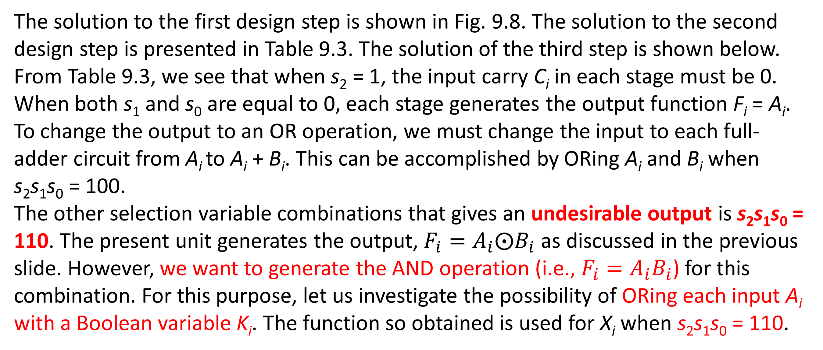
Converting an Arithmetic Circuit to Logic Circuit
The solution to the first design step is shown in Fig. 9.8. The solution to the second design step is presented in Table 9.3. The solution of the third step is shown below.
From Table 9.3, we see that when s₂ = 1, the input carry C_{i} in each stage must be 0. When both s₁ and s₀ are equal to 0, each stage generates the output function F_{i} = A_{i}. To change the output to an OR operation, we must change the input to each full-adder circuit from A_{i} to A_{i} + B_{i}. This can be accomplished by ORing A_{i} and B_{i} when s₂s₁s₀ = 100.
The other selection variable combinations that gives an undesirable output is s₂s₁s₀ = 110. The present unit generates the output, $F_{i}=A_{i}{⨀B}_{i}$ as discussed in the previous slide. However, we want to generate the AND operation (i.e., $F_{i}=A_{i}B_{i}$) for this combination. For this purpose, let us investigate the possibility of ORing each input A_{i} with a Boolean variable K_{i}. The function so obtained is used for X_{i} when s₂s₁s₀ = 110.

Slide 27
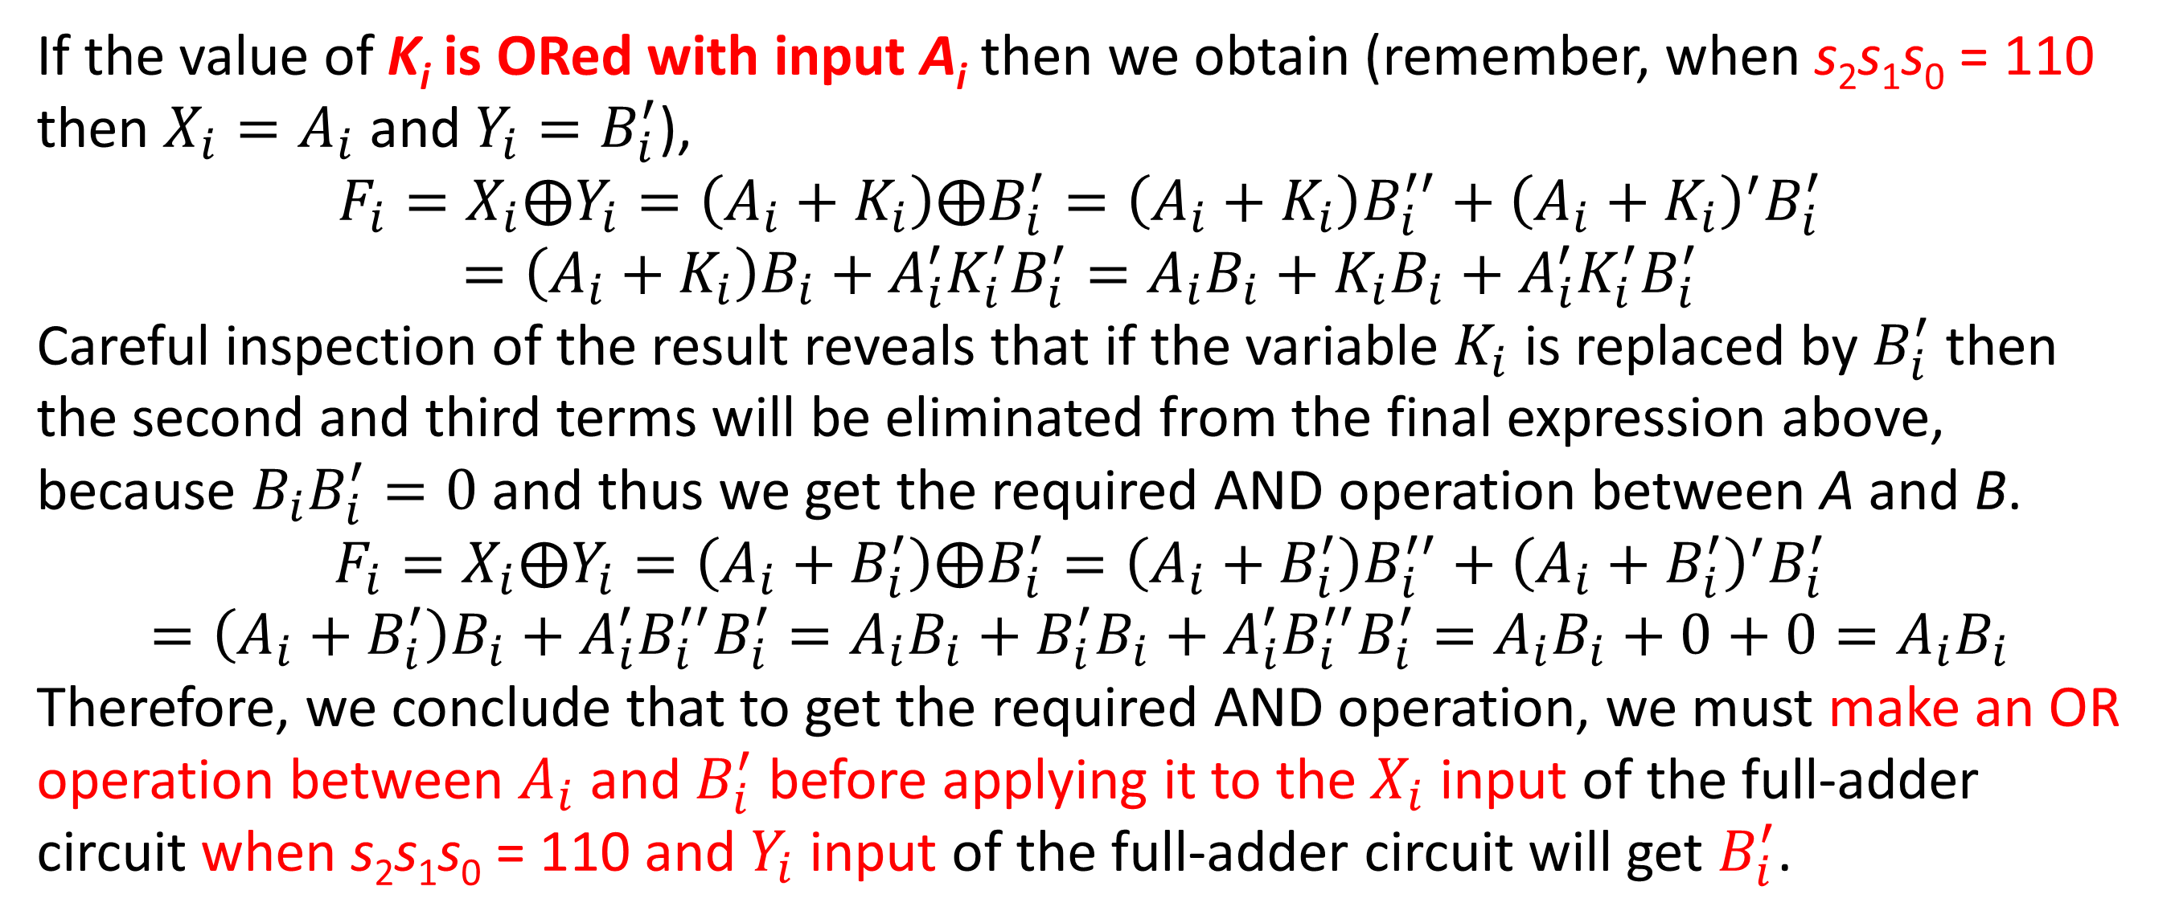
Converting an Arithmetic Circuit to Logic Circuit
If the value of K_{i} is ORed with input A_{i} then we obtain (remember, when s₂s₁s₀ = 110 then $X_{i}=A_{i}$ and $Y_{i}=B_{i}^{′}$),
$$F_{i}=X_{i}⨁Y_{i}=\left(A_{i}+K_{i}\right)⨁B_{i}^{′}=\left(A_{i}+K_{i}\right)B_{i}^{′′}+{\left(A_{i}+K_{i}\right)}^{′}B_{i}^{′}=\left(A_{i}+K_{i}\right)B_{i}+{A_{i}^{′}K_{i}^{′}B}_{i}^{′}=A_{i}B_{i}+K_{i}B_{i}+{A_{i}^{′}K_{i}^{′}B}_{i}^{′}$$
Careful inspection of the result reveals that if the variable $K_{i}$ is replaced by $B_{i}^{′}$ then the second and third terms will be eliminated from the final expression above, because $B_{i}B_{i}^{′}=0$ and thus we get the required AND operation between A and B.
$$F_{i}=X_{i}⨁Y_{i}=\left(A_{i}+B_{i}^{′}\right)⨁B_{i}^{′}=\left(A_{i}+B_{i}^{′}\right)B_{i}^{′′}+{\left(A_{i}+B_{i}^{′}\right)}^{′}B_{i}^{′}=\left(A_{i}+B_{i}^{′}\right)B_{i}+{A_{i}^{′}B_{i}^{′′}B}_{i}^{′}=A_{i}B_{i}+B_{i}^{′}B_{i}+{A_{i}^{′}B_{i}^{′′}B}_{i}^{′}=A_{i}B_{i}+0+0=A_{i}B_{i}$$
Therefore, we conclude that to get the required AND operation, we must make an OR operation between $A_{i}$ and $B_{i}^{′}$ before applying it to the $X_{i}$ input of the full-adder circuit when s₂s₁s₀ = 110 and $Y_{i}$ input of the full-adder circuit will get $B_{i}^{′}$.

Slide 28
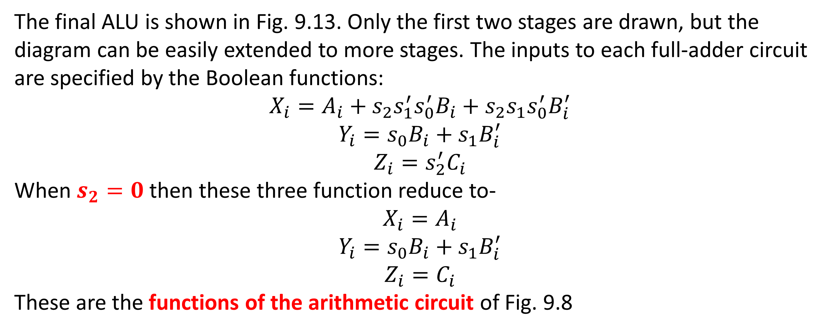
Converting an Arithmetic Circuit to Logic Circuit
The final ALU is shown in Fig. 9.13. Only the first two stages are drawn, but the diagram can be easily extended to more stages. The inputs to each full-adder circuit are specified by the Boolean functions:
$$X_{i}=A_{i}+s_{2}s_{1}^{′}s_{0}^{′}B_{i}+{s_{2}s_{1}s_{0}^{′}B}_{i}^{′}$$
$$Y_{i}=s_{0}B_{i}+{s_{1}B}_{i}^{′}$$
$$Z_{i}=s_{2}^{′}C_{i}$$
When $s_{2}=0$ then these three function reduce to-
$$X_{i}=A_{i}$$
$$Y_{i}=s_{0}B_{i}+{s_{1}B}_{i}^{′}$$
$$Z_{i}=C_{i}$$
These are the functions of the arithmetic circuit of Fig. 9.8

Slide 29
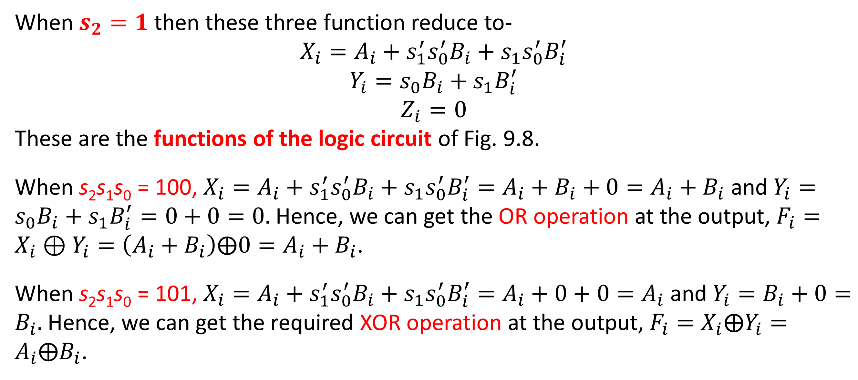
Converting an Arithmetic Circuit to Logic Circuit
When $s_{2}=1$ then these three function reduce to-
$$X_{i}=A_{i}+s_{1}^{′}s_{0}^{′}B_{i}+{s_{1}s_{0}^{′}B}_{i}^{′}$$
$$Y_{i}=s_{0}B_{i}+{s_{1}B}_{i}^{′}$$
$$Z_{i}=0$$
These are the functions of the logic circuit of Fig. 9.8.
When s₂s₁s₀ = 100, $X_{i}=A_{i}+s_{1}^{′}s_{0}^{′}B_{i}+{s_{1}s_{0}^{′}B}_{i}^{′}=A_{i}+B_{i}+0=A_{i}+B_{i}$ and $Y_{i}=s_{0}B_{i}+{s_{1}B}_{i}^{′}=0+0=0.$Hence, we can get the OR operation at the output, $F_{i}=X_{i}⊕Y_{i}=\left(A_{i}+B_{i}\right)⨁0=A_{i}+B_{i}$.
When s₂s₁s₀ = 101, $X_{i}=A_{i}+s_{1}^{′}s_{0}^{′}B_{i}+{s_{1}s_{0}^{′}B}_{i}^{′}=A_{i}+0+0=A_{i}$ and $Y_{i}=B_{i}+0=B_{i}.$Hence, we can get the required XOR operation at the output, $F_{i}=X_{i}⨁Y_{i}=A_{i}⨁B_{i}$.

Slide 30
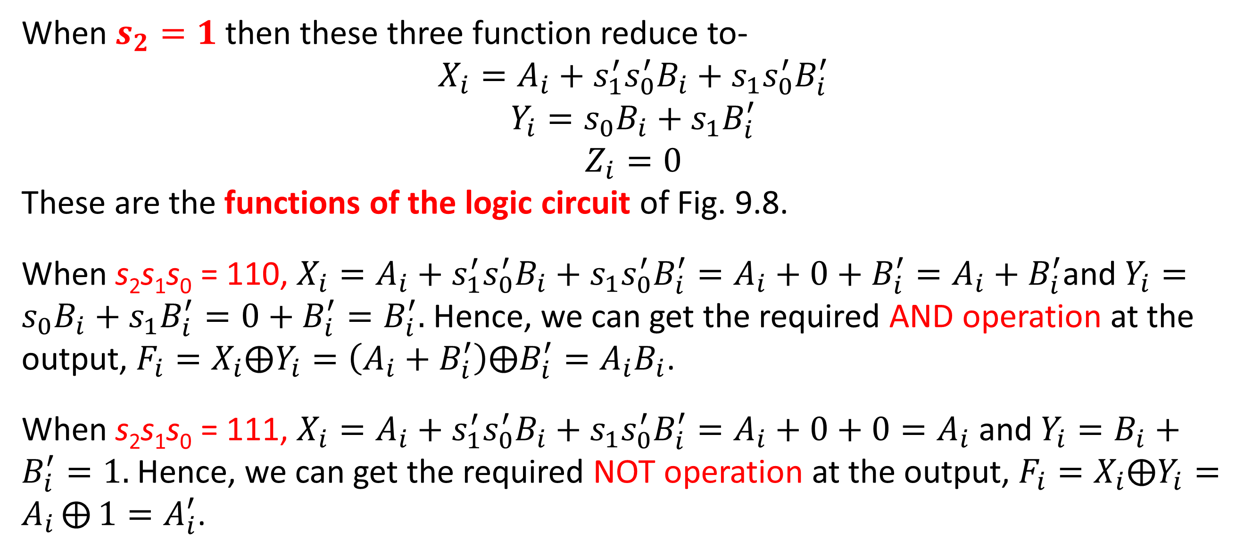
Converting an Arithmetic Circuit to Logic Circuit
When $s_{2}=1$ then these three function reduce to-
$$X_{i}=A_{i}+s_{1}^{′}s_{0}^{′}B_{i}+{s_{1}s_{0}^{′}B}_{i}^{′}$$
$$Y_{i}=s_{0}B_{i}+{s_{1}B}_{i}^{′}$$
$$Z_{i}=0$$
These are the functions of the logic circuit of Fig. 9.8.
When s₂s₁s₀ = 110, $X_{i}=A_{i}+s_{1}^{′}s_{0}^{′}B_{i}+{s_{1}s_{0}^{′}B}_{i}^{′}=A_{i}+0+B_{i}^{′}=A_{i}+B_{i}^{′}$and $Y_{i}=s_{0}B_{i}+{s_{1}B}_{i}^{′}=0+B_{i}^{′}=B_{i}^{′}.$Hence, we can get the required AND operation at the output, $F_{i}=X_{i}⨁Y_{i}=\left(A_{i}+B_{i}^{′}\right)⨁B_{i}^{′}=A_{i}B_{i}$.
When s₂s₁s₀ = 111, $X_{i}=A_{i}+s_{1}^{′}s_{0}^{′}B_{i}+{s_{1}s_{0}^{′}B}_{i}^{′}=A_{i}+0+0=A_{i}$ and $Y_{i}=B_{i}+B_{i}^{′}=1.$Hence, we can get the required NOT operation at the output, $F_{i}=X_{i}⨁Y_{i}=A_{i}⨁{1}=A_{i}^{′}$.

Slide 31
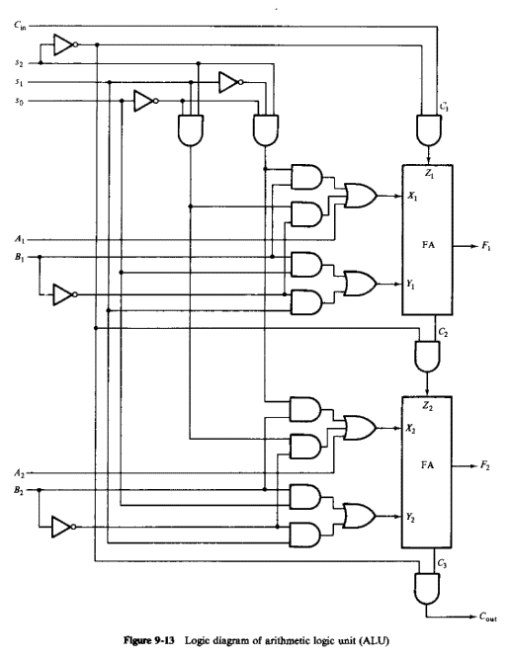
Logic Diagram of ALU (Only first two stages are drawn)
Converting an Arithmetic Circuit to Logic Circuit
Table 9-3
?
?
Figure 9.13: Logic diagram of ALU

Slide 32
Converting an Arithmetic Circuit to Logic Circuit
The 12 operations (8 arithmetic and 4 logical) generated in the ALU are summarized in Table 9.4. The particular function is selected through s₂, s₁, s₀, and C_{in}.
The arithmetic operations are identical to the ones listed for the arithmetic circuit. The value of C_{in} for the four logic functions has no effect on the operations of the unit and those entries are marked as don’t cares (Xs).
Table 9.4

Slide 33
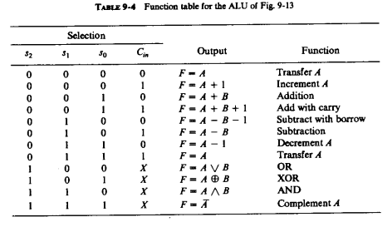
Design of Arithmetic Logic Circuit
X_{i} | Y_{i} | Z_{i}
A | 0 | 0
A | 0 | 1
A | B | 0
A | B | 1
A | B’ | 0
A | B’ | 1
A | 1 | 0
A | 1 | 1
A+B | 0 | 0
A | B | 0
A+B’ | B’ | 0
A | 1 | 0

Slide 34



Design of Arithmetic Logic Circuit (K-maps)
For an arithmetic circuit, we don’t need to change A for X, but for a logic circuit, we need to change A and we don’t need C_{in}. So, we need to use only three variables (s₂, s₁, and s₀) in the K-map.
For both arithmetic and logic circuits, we need to change B for Y for the same combination of s₂, s₁, and s₀, but for a logic circuit, we don’t need C_{in}. So, we need to use only 3 variables (s₂, s₁, and s₀) in the K-map.
For the arithmetic circuit, we need C_{in} for all combinations of s₂, s₁, and s₀, but for a logic circuit, we don’t need C_{in}. So, we need to use all 4 variables (s₂, s₁, s₀, and C_{in}) in the K-map to force C_{in} to zero for Z for the same combination of s₂, s₁, and s₀.
S₀ S₂S₁ | 0 | 1
00 | A | A
01 | A | A
11 | A+B’ | A
10 | A+B | A
S₀ S₂S₁ | 0 | 1
00 | 0 | B
01 | B’ | 1
11 | B’ | 1
10 | 0 | B
S₀C_{in} S₂S₁ | 00 | 01 | 11 | 10
00 | 0 | 1 | 1 | 0
01 | 0 | 1 | 1 | 0
11 | 0 | 0 | 0 | 0
10 | 0 | 0 | 0 | 0
$$X_{i}=A_{i}+s_{2}s_{1}^{′}s_{0}^{′}B_{i}+{s_{2}s_{1}s_{0}^{′}B}_{i}^{′}$$
$$Y_{i}=s_{0}B_{i}+{s_{1}B}_{i}^{′}$$
$$Z_{i}=s_{2}^{′}C_{in}$$

Slide 35
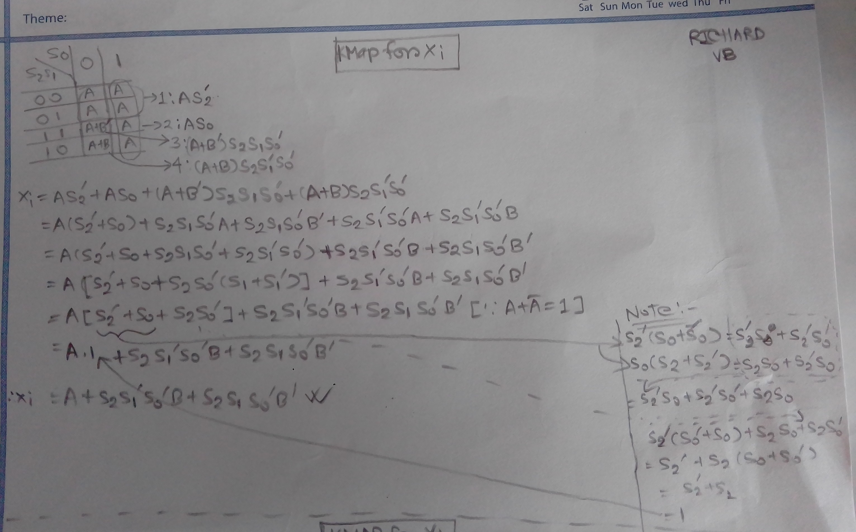
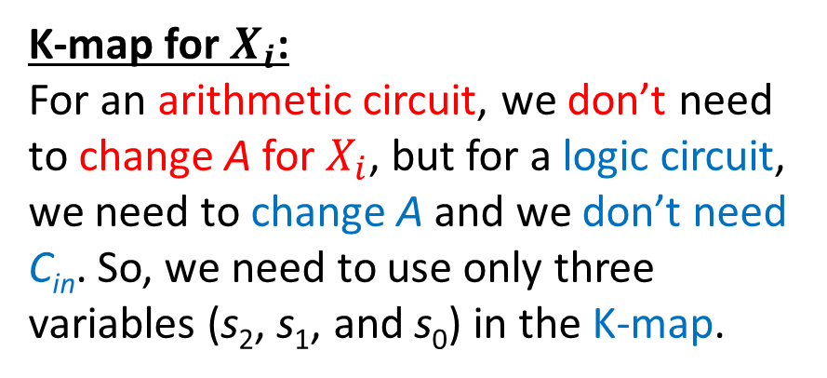

Design of Arithmetic Logic Circuit (K-maps)
K-map for $X_{i}$:
For an arithmetic circuit, we don’t need to change A for $X_{i}$, but for a logic circuit, we need to change A and we don’t need C_{in}. So, we need to use only three variables (s₂, s₁, and s₀) in the K-map.
$$X_{i}=A_{i}+s_{2}s_{1}^{′}s_{0}^{′}B_{i}+{s_{2}s_{1}s_{0}^{′}B}_{i}^{′}$$

Slide 36
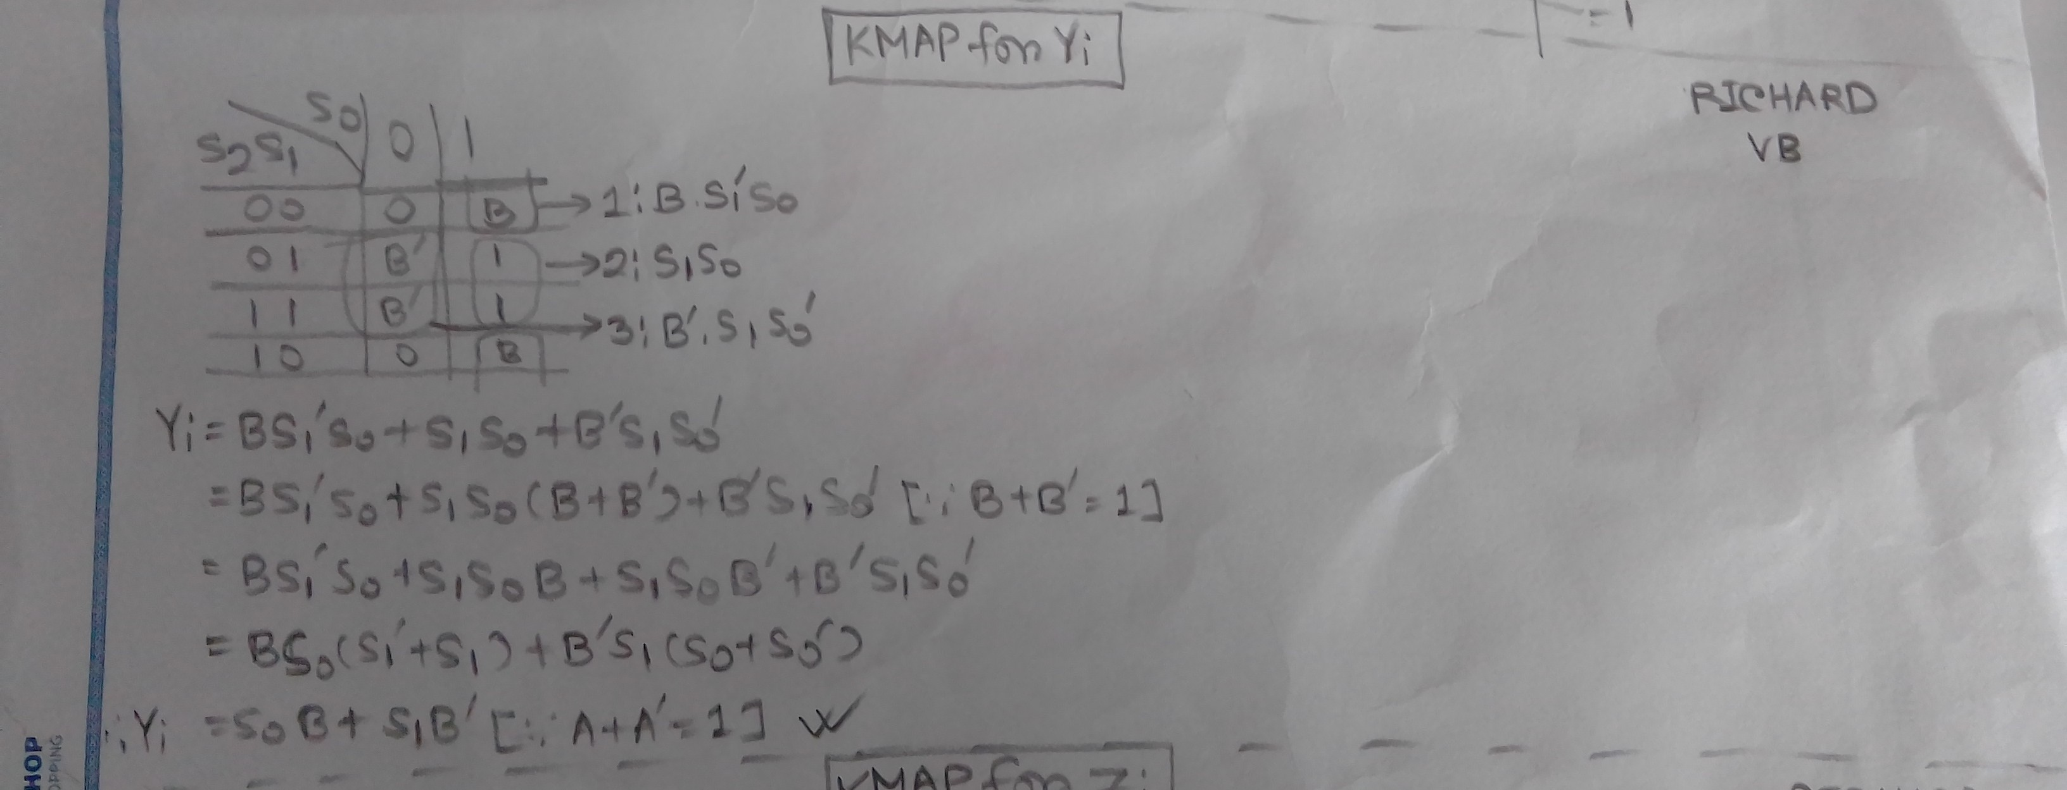


Design of Arithmetic Logic Circuit (K-maps)
K-map for $Y_{i}$:
For both arithmetic and logic circuits, we need to change B for Y for the same combination of s₂, s₁, and s₀, but for a logic circuit, we don’t need C_{in}. So, we need to use only 3 variables (s₂, s₁, and s₀) in the K-map.
$$Y_{i}=s_{0}B_{i}+{s_{1}B}_{i}^{′}$$

Slide 37
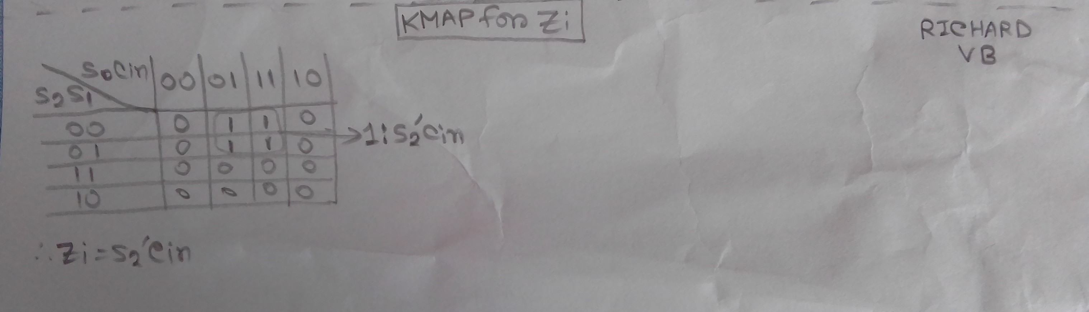
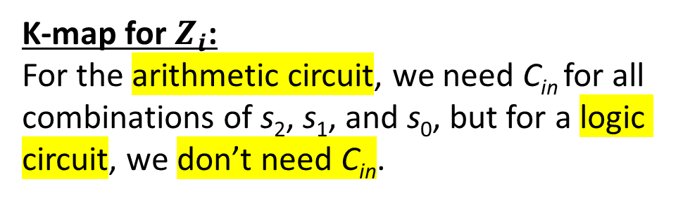

Design of Arithmetic Logic Circuit (K-maps)
K-map for $Z_{i}$:
For the arithmetic circuit, we need C_{in} for all combinations of s₂, s₁, and s₀, but for a logic circuit, we don’t need C_{in}.
$$Z_{i}=s_{2}^{′}C_{in}$$

Slide 38

Design of Arithmetic Logic Circuit
Figure 9.13: Logic diagram of arithmetic logic circuit

Slide 39
Next Class…..
Status Register
Shifter
Design of a processor unit with control variables
Micro operations for processor

Slide 40
Thanks for attending….
?

